Slide 1
2023 Membership Convening 6.27.23
Presented by the Coalition for Homelessness Intervention and Prevention (CHIP) in partnership with the Indianapolis Continuum of Care (CoC) Blueprint Council

Slide 2
Welcome
Pastor David Greene, 2023 Blueprint Council Chair (Appointed- Faith Leader)

Slide 3
AGENDA
Agenda Overview & Grounding
Chelsea Haring-Cozzi, CHIP
Overview of the CoC and Blueprint Council
Chelsea Haring-Cozzi, CHIP
2023 State of Homelessness Presentation
Danielle Bagg Wireman, CHIP
2023 CoC Goal and Key Strategies
Pastor David Greene, Blueprint Council
Call to Action & 2023 Membership Sign-On
Kay Wiles, Blueprint Council
Ray Lay, Blueprint Council
Engagement Opportunities & Next Steps
Kay Wiles, Blueprint Council
Ray Lay, Blueprint Council
Q & A/ Discussion

Slide 4
Groudning
Chelsea Haring-Cozzi, CHIP

Slide 5
Indianapolis Continuum of Care
What?
Collaborative body united under vision that “everyone has the right to be housed and connected to care.”
Why?
Crisis Response
Diversion, Outreach, Assessment, Emergency housing (shelter, transitional housing, safe haven)
Housing, Supportive and Stability Services
How?
Grounded in a collective impact approach focused on operating as a coordinated system
Organized by a governance and implementation infrastructure that brings together key decision-makers, practitioners, and people with lived experience
Who?
To align and organize all homelessness intervention and prevention resources and activities to achieve measurable reduction in homelessness
Collection of individuals and entities committed to aligning resources and activities around shared goals and strategies.
Funders, civic leaders, faith leaders, elected leaders, people with lived experience, advocates
To fully leverage access to and utilization of HUD CoC program funding and mainstream resources to meet the needs of people experiencing homelessness

Slide 6
CoC Structure
Implementation Workgroups
CoC Support Entities
Blueprint Council (Governing Board)
Notes:
CoC Support Entities- Collaborative Applicant (City of Indianapolis, DMD), CoC/HMIS/CES Lead Agency (CHIP)

Slide 7
Blueprint Council
What?
Delegated authority and decision-making body for the Continuum of Care
Why?
Names Seats- Director of IHA and DMD
Appointed Seats- Private Funders, System Representatives, Business, Faith, and University/Research Representatives
How?
Work closely with the Collaborative Applicant and CoC Lead to fulfill HUD requirements
Who?
To ensure adherence to a collaborative, collective approach to ending homelessness.
To provide oversight and leadership to the CoC program and process and inspire improved coordination and performance.
Governance and leadership table that sets strategy, defines annual system priorities and activities, holds vision, and ensures accountability.
Elected Seats- 2 direct homeless service providers, 2 persons with lived experience of homelessness
Ensure transparent governance
Set strategy, align resources, monitor progress
Delegate implementation to committees and workgroups and review and approve policy recommendations

Slide 8
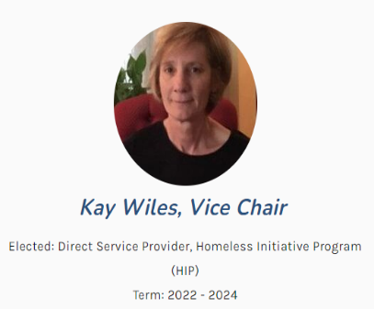
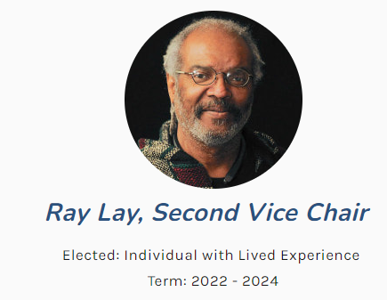
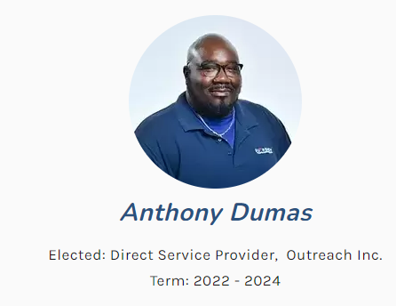
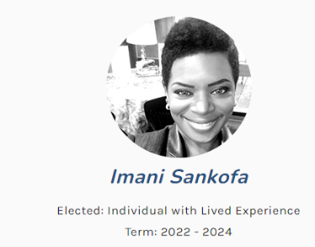
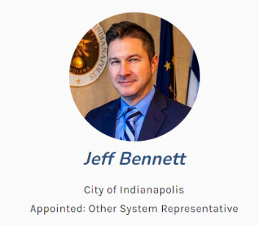
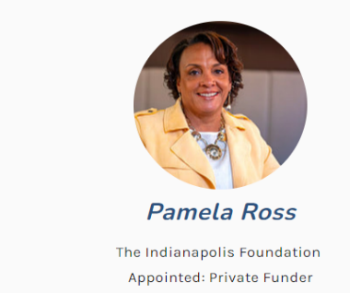
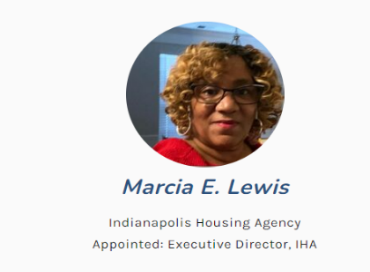
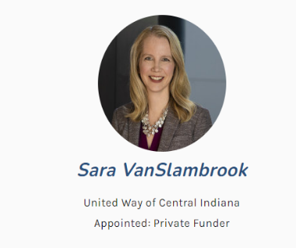
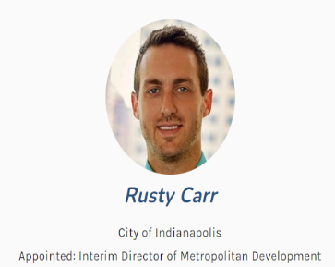
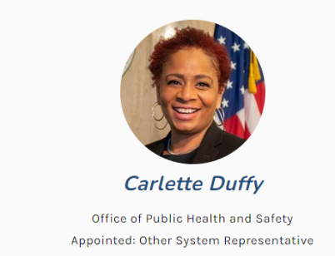
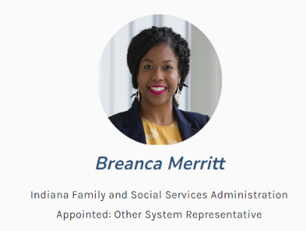
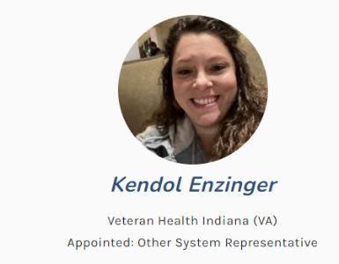
2023 Blueprint Council Members

Slide 9
What unites us?
Everyone has the right to be housed and connected to care
Housing as a human right.
Housing First as a philosophy, model, and practice!
Right now, that is not true!
Notes:
Belief that we are made stronger through participation of a broad and diverse membership that embraces the mission, vision, and goals set forth by the Community Plan and through the Blueprint Council.

Slide 10
State of Homelessness
Danielle Bagg Wireman- CHIP

Slide 11
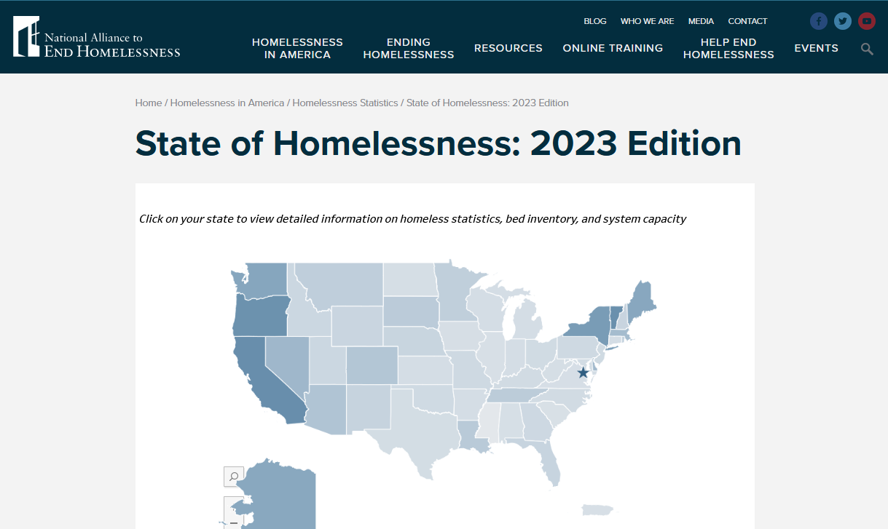
National Trends
https://endhomelessness.org/homelessness-in-america/homelessness-statistics/state-of-homelessness/
Notes:
NAEH recently released State of Homelessness report
Uses PIT and HIC
Static, one night data but used to analyze trends across the nation

Slide 12
Point-in-Time (PIT) Count & Housing Inventory Count (HIC)
Annual, single-night census of those experiencing literal homelessness in cities and Continuums of Care (CoCs) across the country
Mandated activity by the Department of Housing and Urban Development (HUD) used to inform Congress
The PIT is conducted alongside the Housing Inventory Count (HIC) –inventory of beds dedicated to serving those experiencing homelessness
Six programs are captured
Emergency shelter, transitional housing, safe haven, rapid rehousing, permanent supportive housing, other permanent housing

Slide 13
National Trends
Homelessness has been on the rise since 2017, experiencing an overall increase of 6%.
In 2022, counts of individuals (421,392 people) and individuals experiencing chronic homelessness (127,768) reached record highs.
Unsheltered rates are also trending upward, impacting most racial, ethnic, and gender subgroups.
Homeless service systems continued to expand the availability of both temporary and permanent beds in 2022, but these resources still fall short of reaching everyone in need.
https://endhomelessness.org/homelessness-in-america/homelessness-statistics/state-of-homelessness/
Notes:
Homelessness has been on the rise since 2017, experiencing an overall increase of 6%.
In 2022, counts of individuals (421,392 people) and individuals experiencing chronic homelessness (127,768) reached record highs.

Slide 14
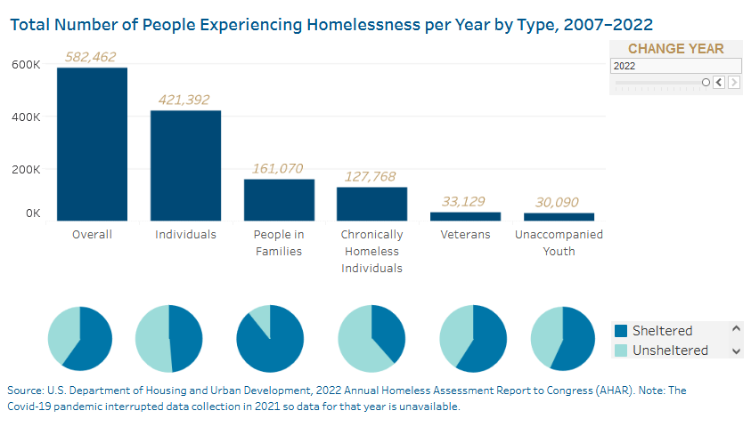
National Trends
https://endhomelessness.org/homelessness-in-america/homelessness-statistics/state-of-homelessness/
Notes:
Homelessness has been on the rise since 2017, experiencing an overall increase of 6%.
In 2022, counts of individuals (421,392 people) and individuals experiencing chronic homelessness (127,768) reached record highs.

Slide 15
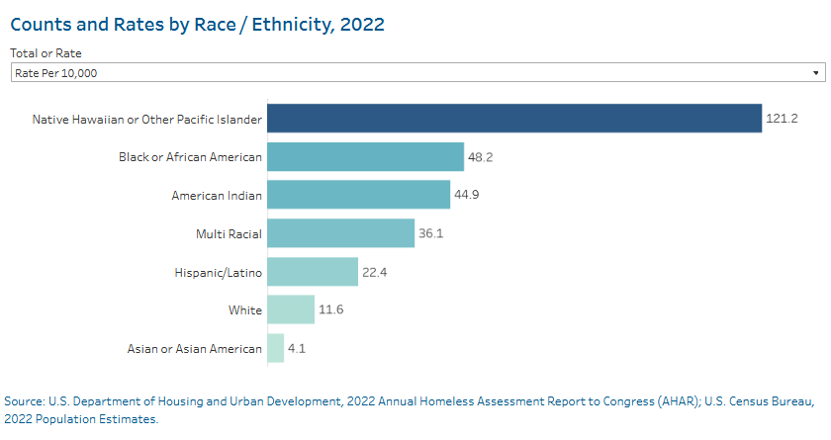
National Trends
https://endhomelessness.org/homelessness-in-america/homelessness-statistics/state-of-homelessness/
Notes:
Homelessness has been on the rise since 2017, experiencing an overall increase of 6%.
In 2022, counts of individuals (421,392 people) and individuals experiencing chronic homelessness (127,768) reached record highs.

Slide 16
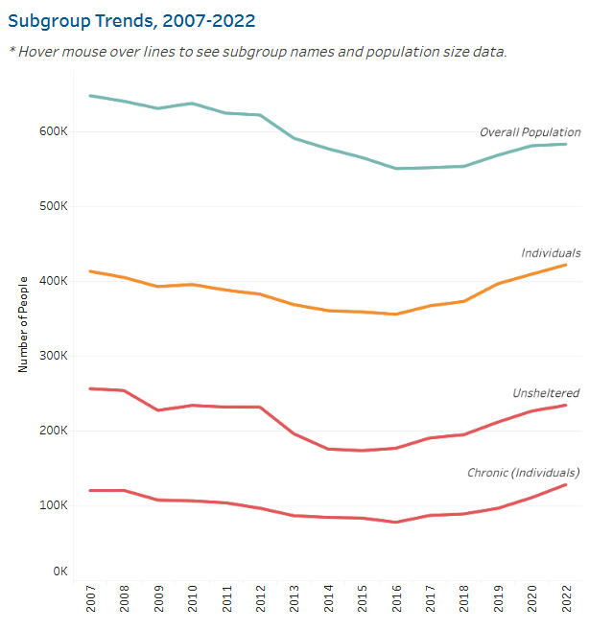
National Trends
https://endhomelessness.org/homelessness-in-america/homelessness-statistics/state-of-homelessness/
Notes:
Homelessness has been on the rise since 2017, experiencing an overall increase of 6%.
In 2022, counts of individuals (421,392 people) and individuals experiencing chronic homelessness (127,768) reached record highs.

Slide 17
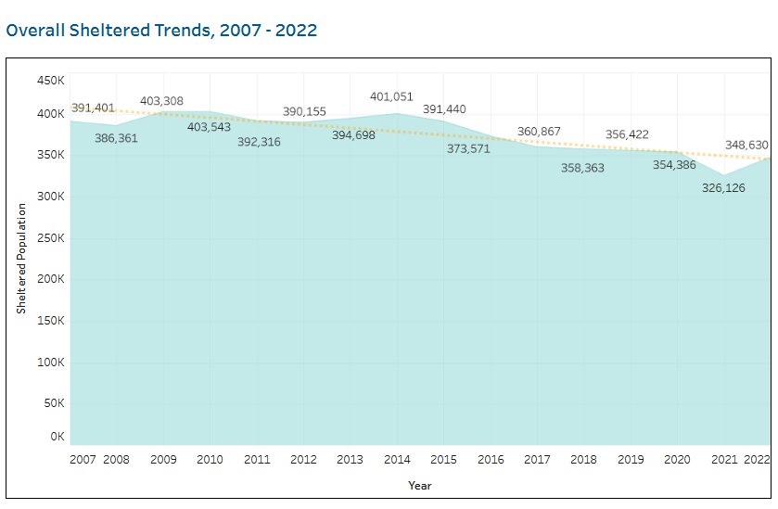
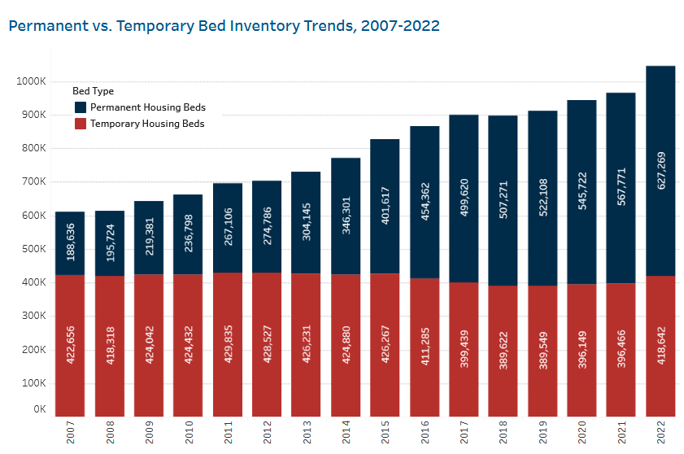
National Trends
https://endhomelessness.org/homelessness-in-america/homelessness-statistics/state-of-homelessness/
Notes:
Homelessness has been on the rise since 2017, experiencing an overall increase of 6%.
In 2022, counts of individuals (421,392 people) and individuals experiencing chronic homelessness (127,768) reached record highs.

Slide 18
Indianapolis trends
https://www.chipindy.org/reports.html

Slide 19
2023 PIT Methodology
Indianapolis PIT
Sheltered Count (PIT/HIC)
HMIS or Comparable System with Data Imports
Survey for non-HMIS participating shelters
Unsheltered Count (PIT)
Night-of-count of known locations survey
Multi-day survey of service/ site-based locations (4 days following night of count)
NEW- electronic survey tool and added site-based locations
NEW- PIT/HIC Portal and enhanced DV comparable database submission into portal

Slide 20
Night of the Count
Indianapolis
PIT
January 23, 2023
Low Temperature: 28° F
100+ Volunteers
Professional Blended Street Outreach (PBSO)
IMPD Homeless Unit
Local service providers
Community Volunteers

Slide 21
2023 Point-in-Time Count Key Points
Indianapolis PIT
Decreases
Overall Total
Emergency Shelter
Increases
Unsheltered
Chronic Homelessness
Racial Disparity at-a-Glance
Lowest 5 years sheltered trend
Black individuals represent:
52% of total PIT population
60% of the shelter population
71% of adults with children
50% of unaccompanied youth (18-24)
43% of veteran population
Unsheltered total at record high
25% over the age of 55

Slide 22
Indianapolis PIT
2023 Point-in-Time Count Totals Overall
2023 Total:
1,619

Slide 23
Indianapolis PIT
2023 Point-in-Time Count Totals By Location

Slide 24
Demographics: Race

Slide 25
Demographics: Race Cont’d

Slide 26
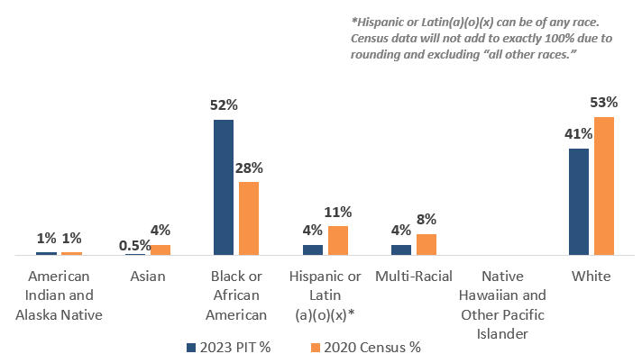
Demographics: Race & Ethnicity

Slide 27
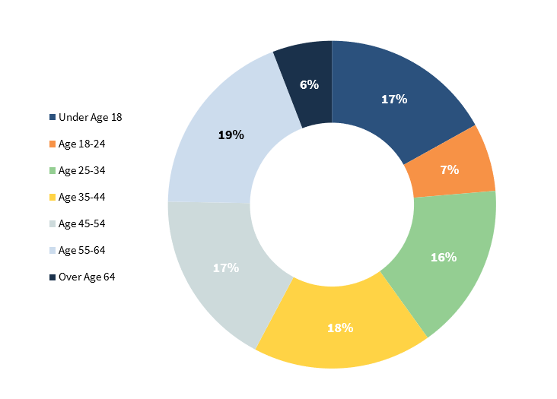
Demographics: Age and Gender

Slide 28
By Sub-Populations

Slide 29
Trends by Sub-population
Decreases
Unaccompanied Youth (18-24)
Individuals in Families
Down from 2022 but still up from 2019-2021
Average family size 3.5
Increases
Chronic homelessness
Veteran homelessness
Up slightly from 2022 but still down significantly from 2019-2021
Unsheltered families

Slide 30
By Reported Vulnerability

Slide 31
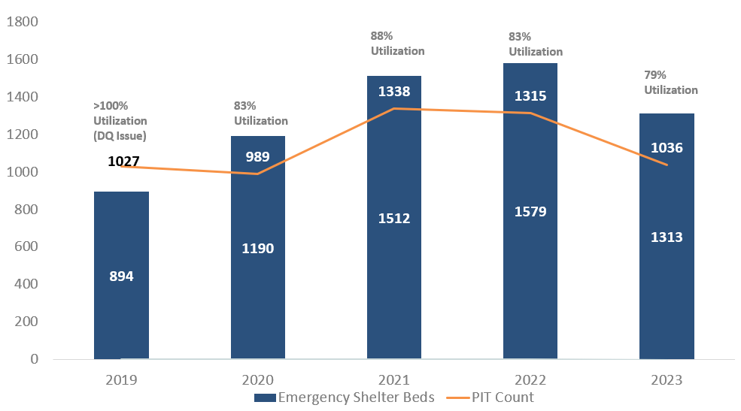
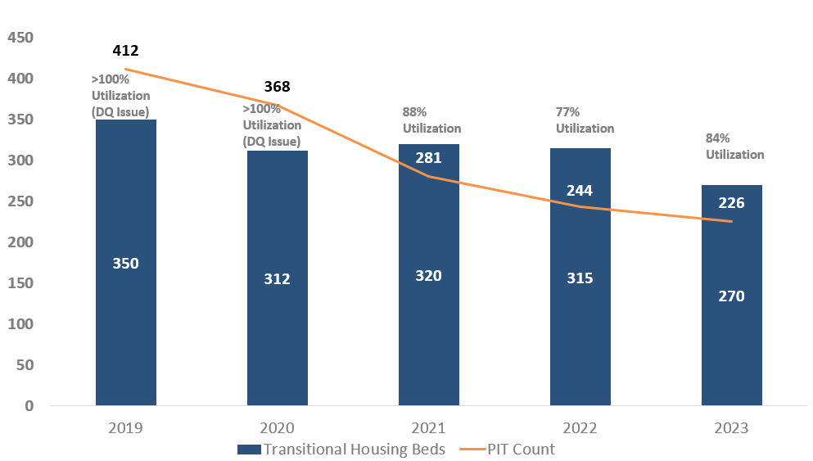
Indianapolis Housing Inventory Count (HIC): Emergency Beds

Slide 32
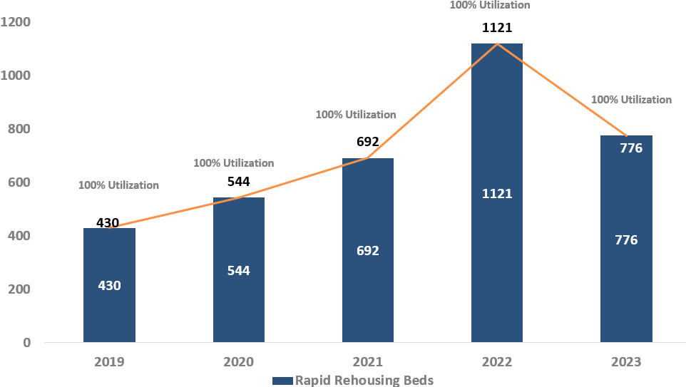
Indianapolis HIC: Permanent Housing

Slide 33
What else?
PIT and HIC are just one night and tell us a limited story

Slide 34
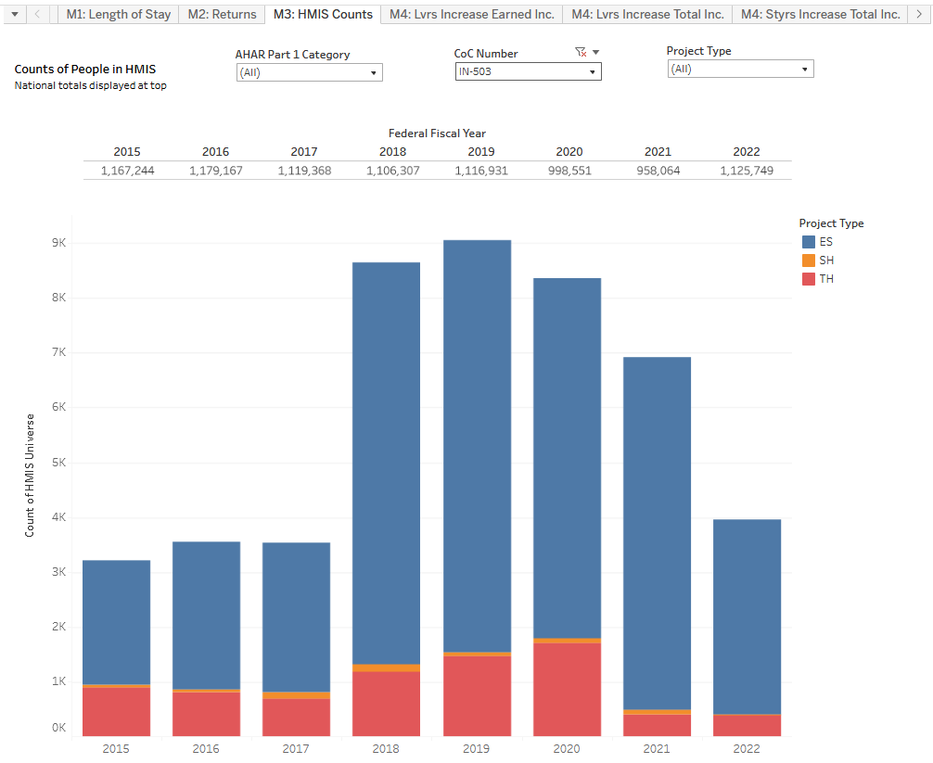
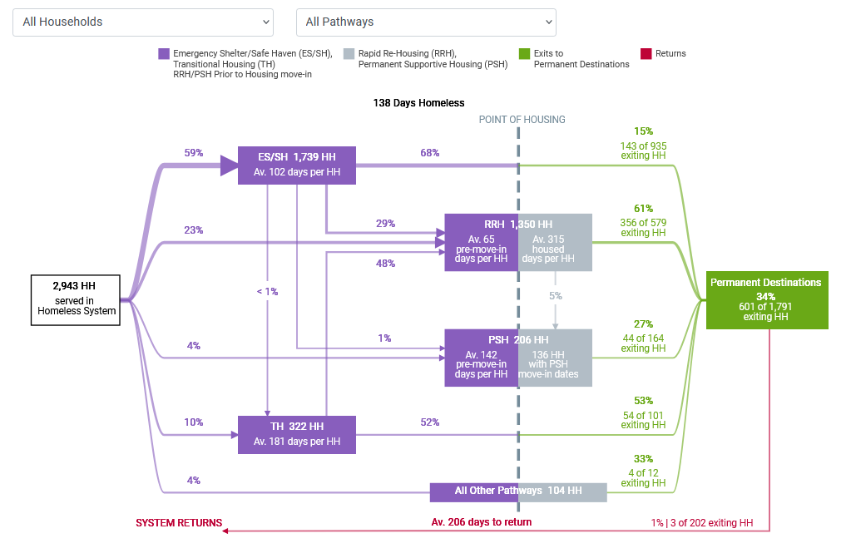
Federal Reporting: System Performance Measures Longitudinal System Analysis
https://public.tableau.com/shared/MH26N75QH?:display_count=n&:origin=viz_share_link
https://stella-p.hudhdx2.info/dashboard/system-map/?id=27587

Slide 35
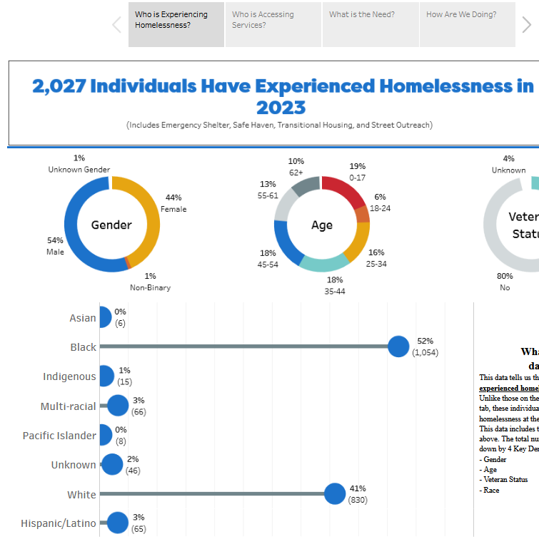
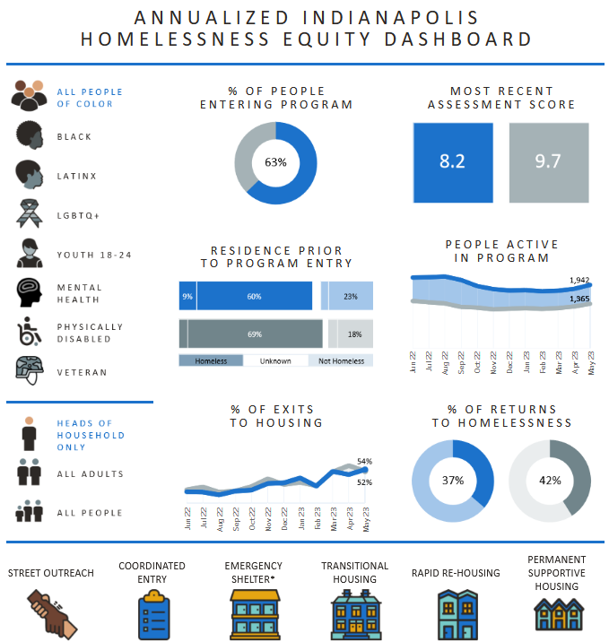
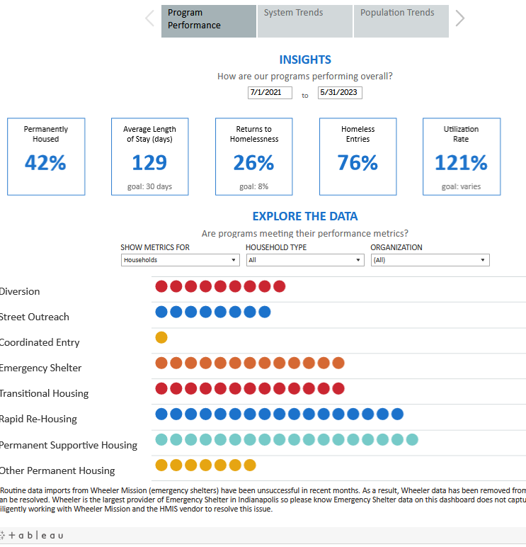
Local Monthly Dashboards
https://www.indycoc.org/coc-dashboards.html

Slide 36
By-Name Lists (BNL)
Enrollment Dates
Into shelter, safe haven, transitional housing, or street outreach
Any from homeless situations
Exit Dates
From shelter, safe haven, transitional housing
Any to literal homelessness
Open Shelter Enrollments
These use today’s date as the event date
Current Living Situations
Only those indicating homelessness
Services
Street outreach contact services
OR any service from a homeless-specific program*

Slide 37
By-Name List Status
Homeless Statuses
Newly Homeless
Return from Housed
Return from Inactive
Active
At least one homeless event in the last 90 days that was immediately preceded by a housed event
Client has homeless events in the last 90 days and earlier, but has a gap between them of at least 90 days
Homeless events in the last 90 days and earlier, not returning fro
They only have homeless events, none older than 90 days
They only have homeless events, none older than 90 days
At least one homeless event in the last 90 days that was immediately preceded by a housed event
Client has homeless events in the last 90 days and earlier, but has a gap between them of at least 90 days
Homeless events in the last 90 days and earlier, not returning from housed

Slide 38
Current By-Name List By Households
Veterans
Youth
Families
Chronic
254
147
232
207

Slide 39
The Whole Picture
Each data source provides insight
Neither data source provides the full picture
HMIS coverage and use is essential!
Taken together, we can see a fuller picture
Quality data is quality care

Slide 40
Unifying goal
Pastor David Greene, 2023 Blueprint Council Chair (Appointed- Faith Leader)

Slide 41
What are we uniting around: CoC Goal
To Reduce Black Homelessness by 35% by January 2025.
To Reduce Black Homelessness by 35% for the following sub-populations:
Chronically homeless
Families
Veterans
Youth (18-24)
Notes:
The Racial Equity Committee of the Blueprint Council began working with TAC in the Fall of 2022 to delve further into racial disparities in the Indianapolis homeless response system. In the Spring 2023, the Blueprint Council engaged in a half-day retreat facilitated to TAC’s Racial Equity Action Lab and established the following 18-month goal to unify the Indianapolis CoC and to be intentional in working to eliminate racial disparities in homelessness and across our homeless response system.

Slide 42
How do we achieve this: Key Tactics
Create an equitable Coordinated Entry process
Implement a post-Covid housing command center (i.e. HomeNow) that coordinates core housing functions and teams
Strengthen supportive services, specifically housing case management.
Notes:
1.) Eliminate the VI-SPDAT, create a new assessment tool that captures Black vulnerability and ensures equitable access to housing and services across all types of housing, and ensure assessors reflect the demographics of those experiencing homelessness, and ensure assessments are happening in the places where Black people are showing up.
2.) Take lessons learned from the non-congregate shelter- cross agency, cross function coordination- and relaunch physical, centralized housing command center under HomeNow to bring together outreach teams, assessors, navigators, case managers, and housing acquisition to form focused, coordinated housing teams and deploy those teams to where people show up in the system.
3.) Expand high-quality, high-performing housing case management services centered in Housing First across the Continuum of Care with a focus on reducing returns to homelessness, which are also higher among Black households.

Slide 43
What values& beliefs are guiding us?
We believe
In acknowledging our role as a system in creating and continuing inequality
We value
Elevating voices of those with lived experience of homelessness and those closest to the problem and solutions who are often furthest from power and resources.
Systems should be driven by equity, inclusion, and choice
In leading with a racial and social equity lens
Sharing power and decision-making with those most impacted
A whole person and healing centered approach
Using data (story telling and numbers) to inform equity-based decision-making and results
Intentionality, accountability, and continuous quality improvement

Slide 44
Call to Action
Kay Wiles, Blueprint Council Vice-Chair (Elected)
Ray Lay, Blueprint Council Second Vice- Chair (Elected)

Slide 45
Call to Action & 2023 Sign On
Notes:
Overview of agreement- asking individuals AND organizations to sign on to these agreements formalizing your (1) support of this goal, (2) your commitment to engage in the various workgroups to advance this goal, and (3) your standing as an active CoC member. These agreements will be reviewed by the Blueprint Council to determine who is aligned and who is not.
CoC Membership, based on these signed agreements, will be posted on the CoC website and listed by organization. CoC Membership, as laid out in the CoC charter, is based on:
Self-identified lived experience of homelessness OR
Commitment to strategic plan to end homelessness as demonstrated by a signed membership statement
Membership includes authority to vote for elected BPC seats and for charter/governance changes

Slide 46
How to engage? Tactical Spaces
HomeNow Housing Hub
Coordinated Entry Redesign
Case Management Roundtable
Facilitative Lead: Danielle Bagg Wireman (CHIP)
Danielle@chipindy.org
Facilitative Lead: Sara Nowlin (CHIP), LaMont Green (TAC), Nastacia Moore (TAC)
Snowlin@chipindy.org
Facilitative Lead: TBD
Sub-workgroups with leads: Chronic, Veterans, Families, and Youth
*Every group/ implementation space will ensure black voice and lived experience of homelessness are included
Notes:
Each of these tactical areas with have a set of workgroups that will be convening primarily in-person to operationalize strategies, dig into data and by-name lists, and create action plans that will be shared with the Blueprint Council. Workgroup membership will be tracked by member, affiliation, and demographics and reported to the Blueprint Council. Workgroups will begin launching in July.

Slide 47
Next Steps
Review and Sign Membership Statements
Reach out or be responsive to workgroup engagement opportunities
Plan to reconvene in September (Date, TBD)
By July 14th, 2023
Recommend and help recruit more people with lived experience of homelessness
Will evaluate progress and engagement
Commit to working together differently
Be a champion of this goal!
Go back and discuss this within your organization and sphere of influence to help unite around this goal!

Slide 48
Contact Information
Blueprint Council Elected Representatives- Executive Council
Kay Wiles
(Service Provider Seat, Vice-Chair) Kay.Wiles@indyhealthnet.org
Ray Lay
(Lived Experience Seat, 2nd Vice-Chair)
raylay@smienterprises.org
Questions/ Discussion
Check out our website – www.indycoc.org
Visit us on social media:

